Slide 1
This Is US
By: David Etz

Slide 2
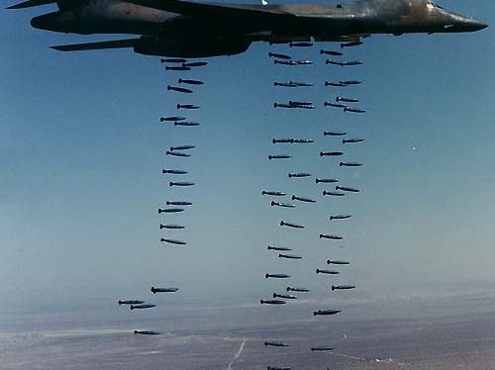
Violence is like a Bomb
just waiting to go off

Slide 3
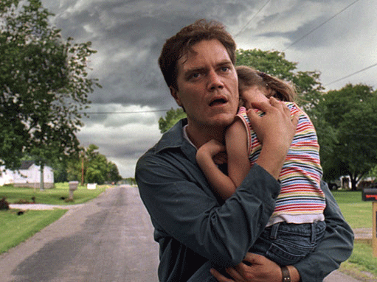
Violence is a man protecting his Family
when he knows all hope is lost

Slide 4
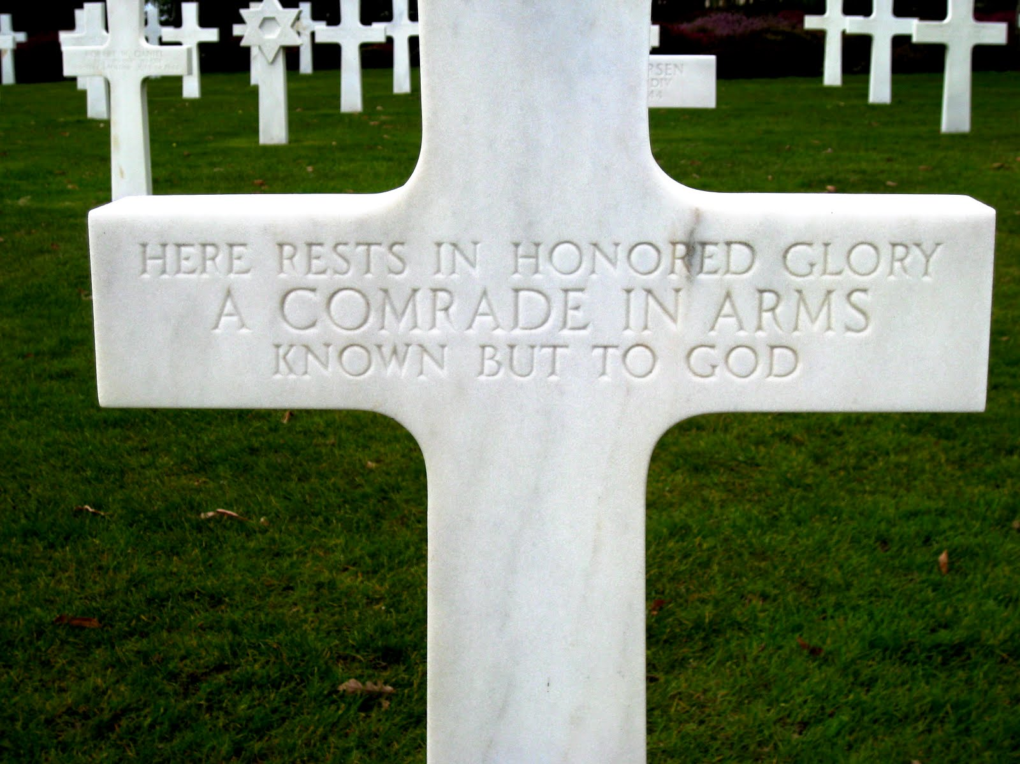
Violence is like the Pain
when a soldier did not come home

Slide 5
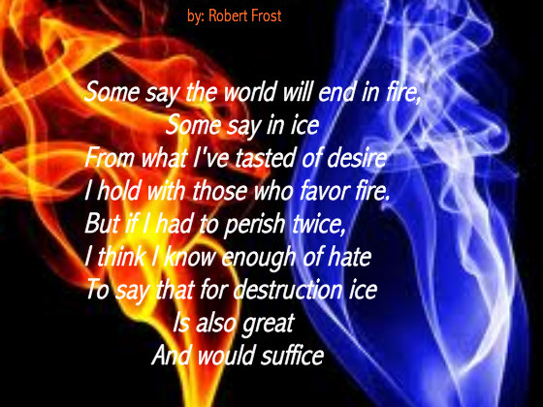
Violence is a Poem
That attacks the souls of its readers, an unbearable cost

Slide 6
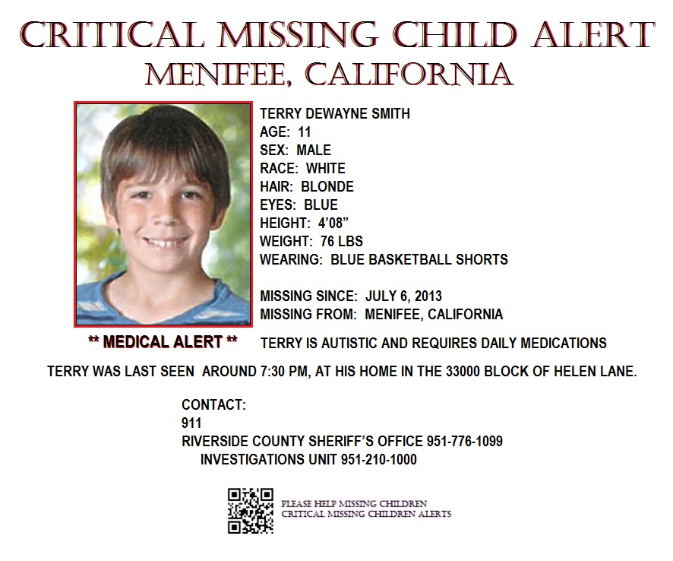
Violence is like a lost loved one
Left all alone

Slide 7
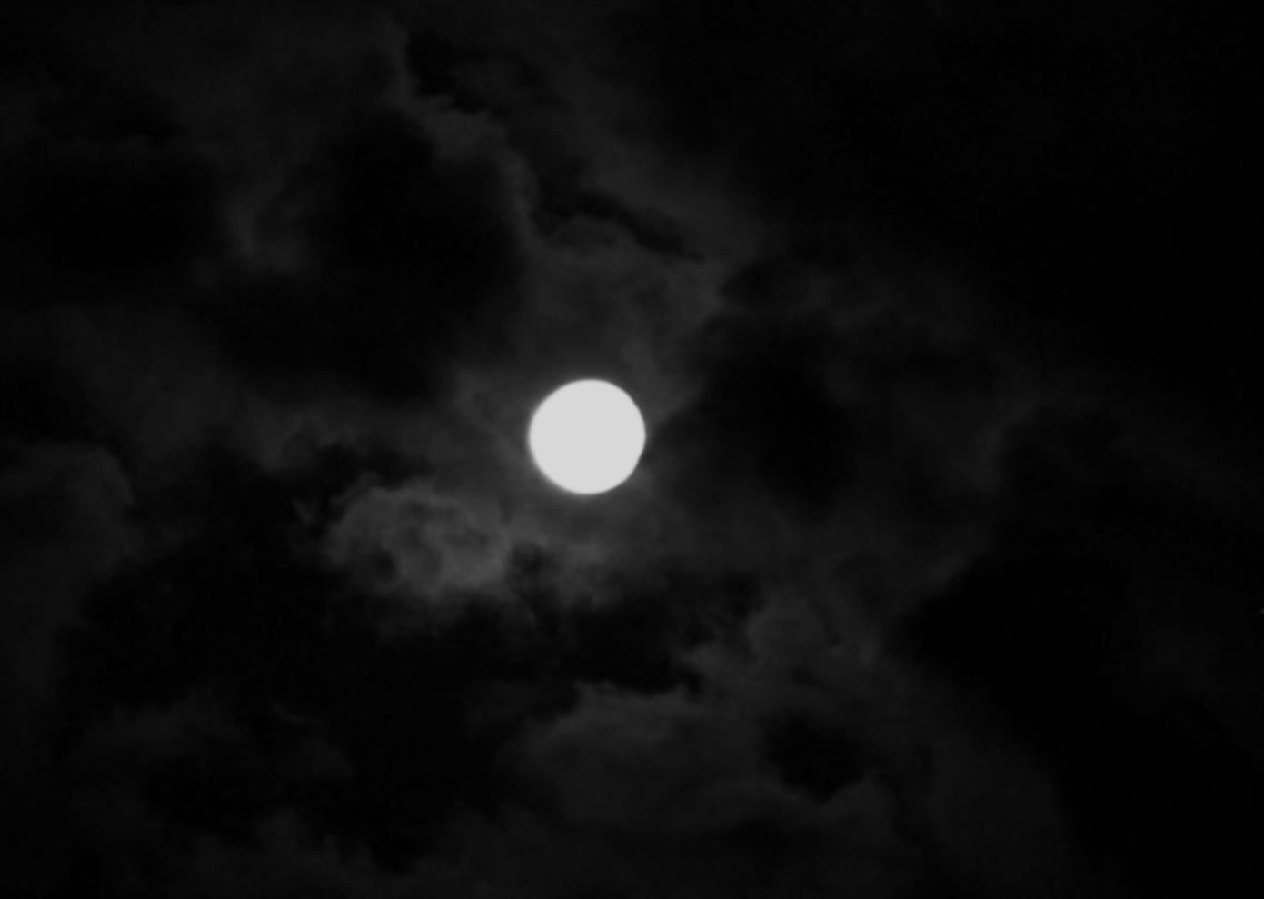
Violence is the Dark
Before the dawn

Slide 8
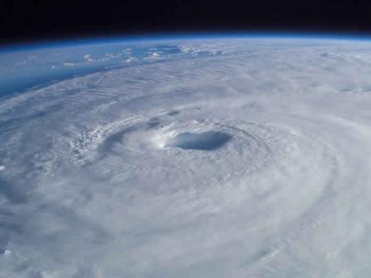
Forcefulness is a raging hurricane
A terrible disaster, an endless fray

Slide 9
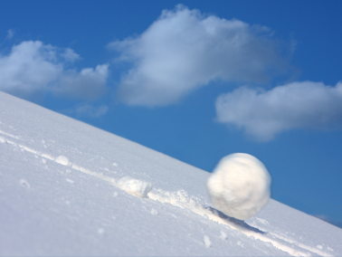
Viciousness is like a snow ball
Billowing down a mountain, picking up mass

Slide 10
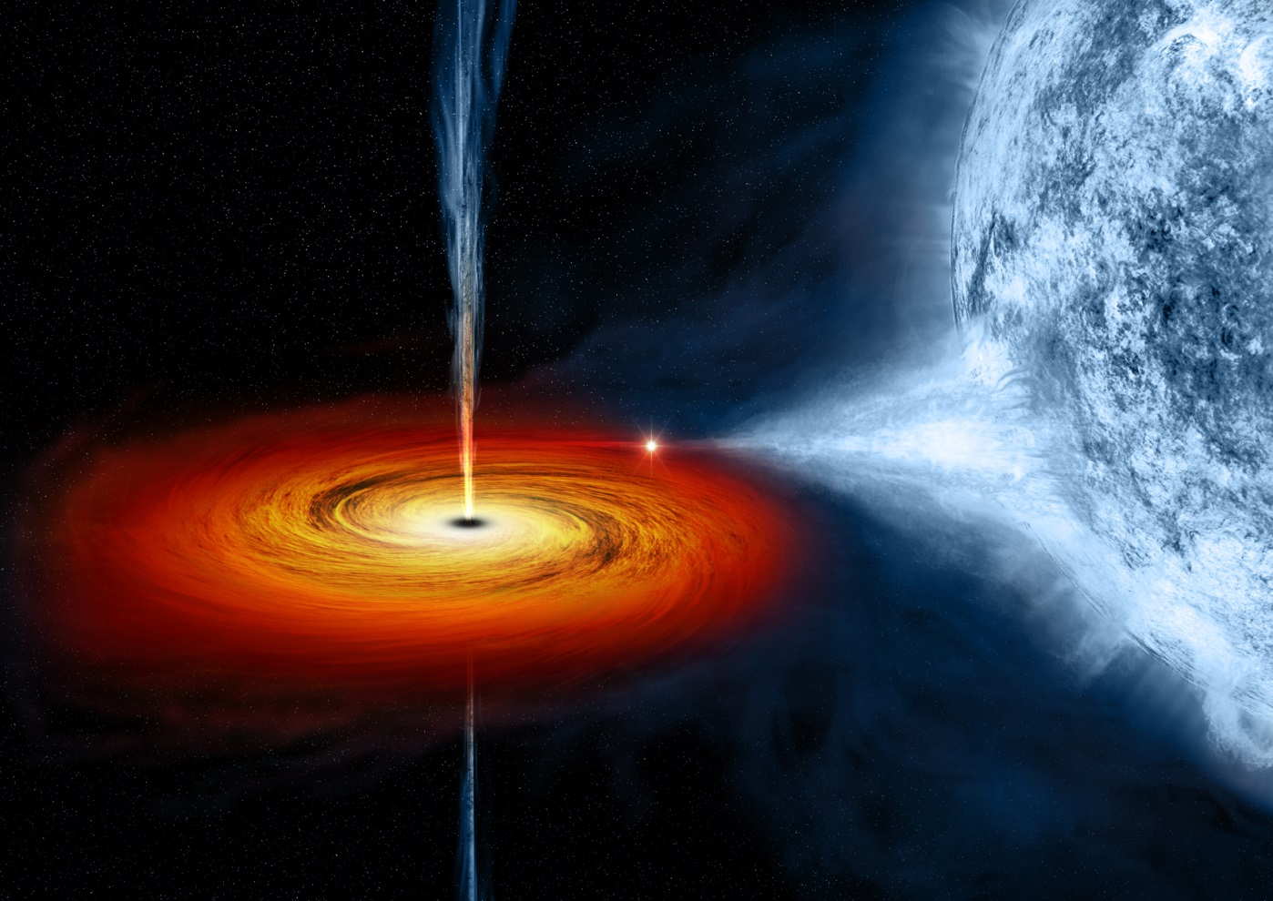
Strength is a black hole
Sucking a way the light of the day

Slide 11
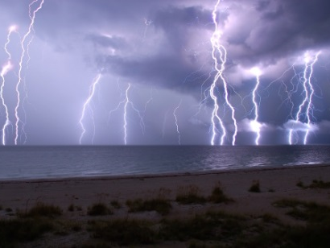
Ferocity is the storm
After the calm, on it’s own class

Slide 12
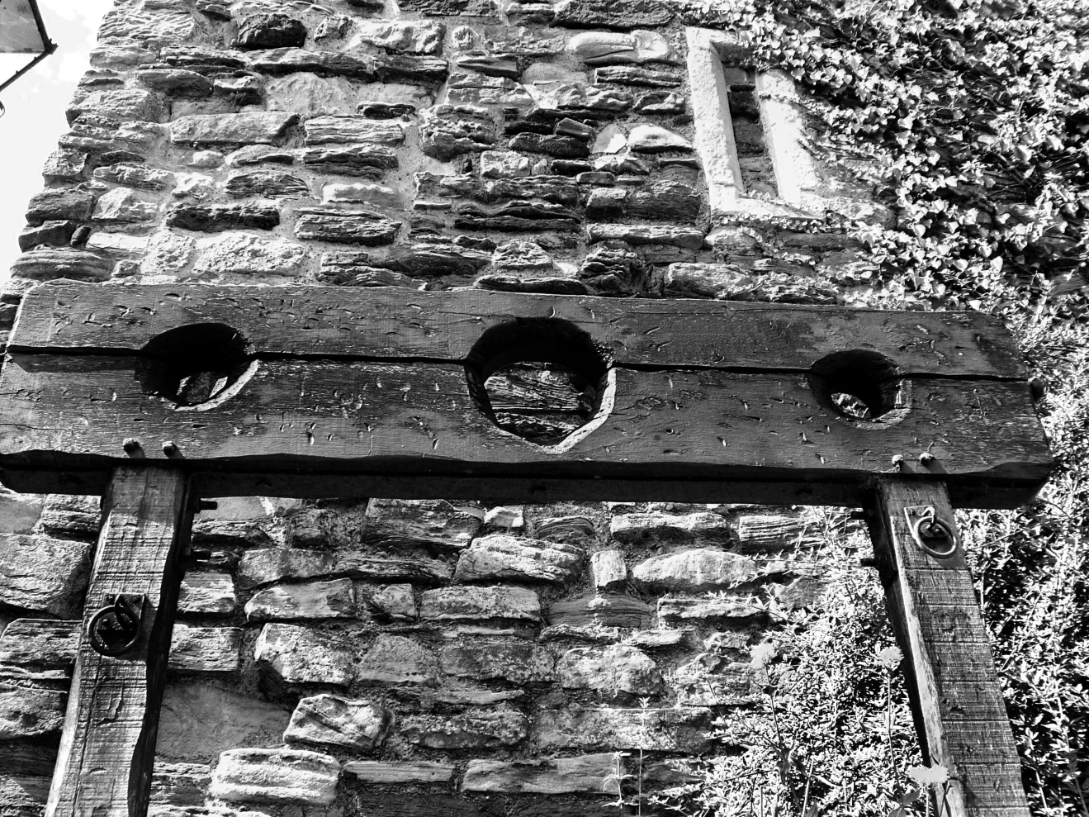
Violence is the punishment
For our mistake

Slide 13
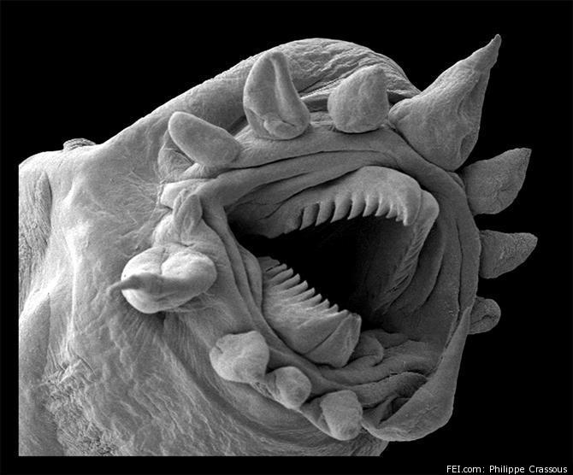
A virus
That will destroy us

Slide 14

The Human Race

